Slide 1
HSO Strategic Framework Implementation Plan
November 30, 2016

Slide 2
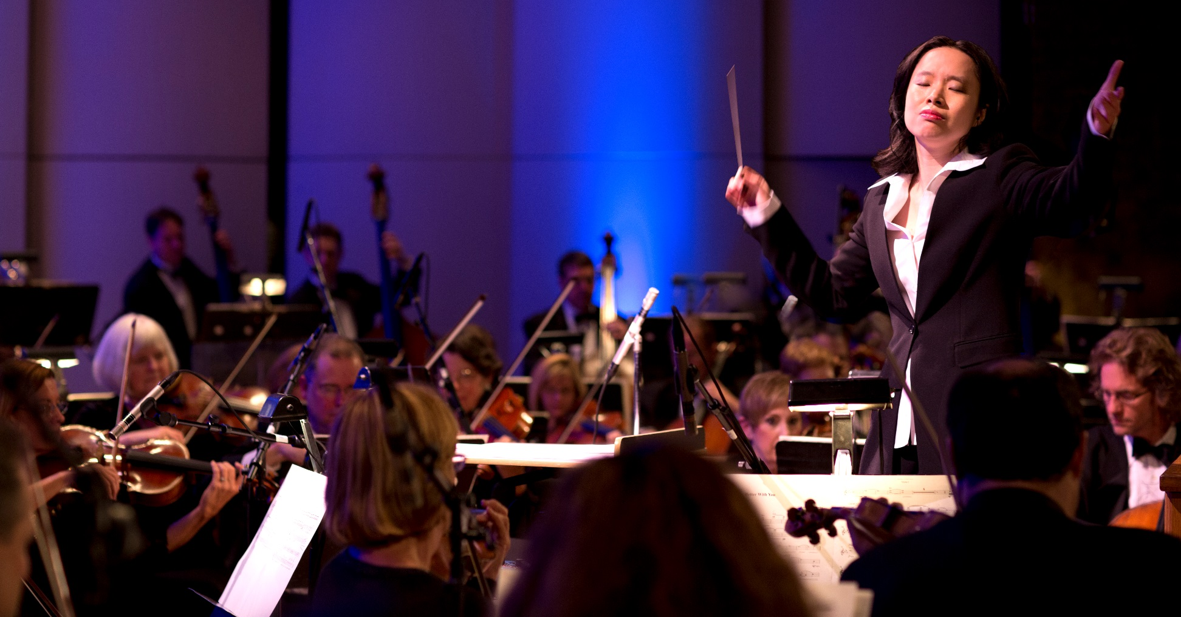
Mission Statement
To enrich lives and community through great music.

Slide 3
Total Earned Revenue – Ticket Sales, Fees, Other Inc: FY14-FY17 Budget
Note: FY17 Goal = $1.8 million with 9 fewer MW concerts and 2 fewer POPS! Concerts.

Slide 4
Concert Activity – Masterworks Revenue
109%
102%
91%
71%
52%
57%
56%
64%
54%
Budget exceeded

Slide 5
Concert Activity – POPS! Revenue
41%
49%
22%
36%

Slide 6
Concert Activity – Talcott Mountain Music Festival Revenue
0%
0%
0%
0%
0%

Slide 7
Event Margins vs Budget – Completed Performances, Major Concert Series

Slide 8
Earned Revenue by Series: FY14 – FY17 Budget

Slide 9
Total Contributed Revenue: FY14 – FY17 Budget

Slide 10
Contributed Revenue: FY14 – FY17 Budget

Slide 11
Fundraising to Date vs. 2016

Slide 12
Total Operating Expenses: FY14 – FY17 Budget

Slide 13
Total Operating Deficit: FY14 – FY17 Budget

Slide 14
Major Strategy Initiatives
1.
Stabilize & Grow the HSO’s Model
2.
Stabilize & Expand Core and Penetrate New Audience Segments
Patron Centric Model
Strengthen
HSO Brand
3.
Maximize the Concert Experience
4.
Serve Our Community
5.
Foster a Collaborative Culture

Slide 15
Key To Progress Indicators
 | On Schedule
 | Progressing But With Some Challenges
 | Behind Schedule
 | Not Yet Commenced

Slide 16
1. Stabilize and Grow the HSO’s Model
Policy & Procedure | Balanced budgeting Zero-based budgeting Enhancing communication and transparency enabling BoD to focus on strategy vs. tactics
Financial Performance | Staff, Board and volunteer personnel Campaign goals, strategy and tactics Segmentation and overlap of funding sources, donors Supporting events

Slide 17
1. Stabilize and Grow the HSO’s Model:
Policy & Procedure
 | Progress
Create achievable, balanced FY17 organization budget
Implement zero-based program and organization development
Negotiate collective bargaining agreements
Negotiate vendor agreements in support of organizational development & fiscal responsibility
Share financial performance and strategic framework implementation with appropriate stakeholders (Staff, musicians, Board, donors, etc.)
Create Board meeting agendas and communication that focuses on high level strategic considerations versus tactics

Slide 18
1. Stabilize and Grow the HSO’s Model:
Financial Performance 1 of 2
 | Progress
Prioritize and aggressively recruit the appropriate personnel to facilitate organizational development Facilitate Governance Committee execution of board personnel analysis and recruitment
Develop comprehensive Director orientation program
Develop Board and Committee Vice Chairs, fully evaluate term limits, explore secondary Board
Design and execute major fundraising campaigns
Expand base of corporate, foundation, and government funders through personal contacts
Facilitate Governance Committee execution of board personnel analysis and recruitment
Establish network of external commercial production partners to develop a portfolio of revenue producing projects (i.e., Touring productions, licensing fees, electronic distribution)

Slide 19
1. Stabilize and Grow the HSO’s Model:
Financial Performance 2 of 2
 | Progress
Design and implement capital campaign
Clearly articulate purpose of campaign, associated funds and goals
Establish Initial Goal: ($TBD) in commitments by end of 75th Anniversary (FY 2019)
Develop comprehensive gift acceptance policy, including planned giving
Identify and recruit leadership committee and chairperson, staff leadership
Analyze donor base to develop tiered prospect list & develop comprehensive data-driven plan (individuals, corporations, foundations, internal constituencies)
Develop donor recognition plan
Develop marketing strategy and collateral materials
Identify potential economic stresses and develop mitigation strategies
Launch quiet phase of campaign and establish timeline for launch of public phase

Slide 20
2. Stabilize & Expand Core and Penetrate New Audience Segments
Marketing Fundamentals | Audience retention & lapsed customers Concert & event campaigns Promoting frequency Pricing and packaging
Engagement & Brand Identity | How we communicate with our patrons HSO website, social media, publications, surveys, print media Mission statement & vision, brand house, physical attributes (logos, fonts, colors, styles, etc.) Institutional messaging

Slide 21
2. Stabilize & Expand Core and Penetrate New:
Marketing Fundamentals
 | Progress
More fully understand HSO customer buying patterns Review existing HSO customer data to identify buying patterns across concert series & identify lapsed customers over a three year period
Develop comprehensive customer experience program to promote frequency
Leverage existing outreach communications to capture greater mindshare and drive revenue (i.e., Symphon-eNews, Prelude and Quarter Notes publications)
Establish unique campaigns for targeted new audiences based on concert series, musical and non-musical affinities

Slide 22
2. Stabilize & Expand Core and Penetrate New:
Engagement & Brand Identity
 | Progress
Refine and amplify HSO’s brand to reflect diversity of programming & community reach
Establish Bushnell/HSO marketing committee, sub-committees and provide a clear charge
Develop institutional messaging, brand house and personality
Develop communication plan for brand house & integrate with concert and event marketing
Develop crisis communications program, key messages and recovery mechanisms
Perform an assessment of HSO’s digital capacity (website, social media, digital marketing, analytics, staff and external resources) and identify deficiencies

Slide 23
3. Maximize the Concert Experience
Patron Engagement | From purchasing ticket to being seated to after the concert experience
Performance | Programming; what we are playing Guest artists and conductors Concert experience; how we present the music and the orchestra Execution; perceived quality

Slide 24
3. Maximize the Concert Experience:
Patron Engagement
 | Progress
More fully understand HSO market
Review existing HSO research including the Corbin study, develop key findings and actions to improve programming, service & customer experience
Seek regular feedback from patrons across all concert series
Develop customer service map to identify all points of contact and identify improvements
Identify additional research needed & assess potential sources
Develop additional customer feedback mechanisms as needed for new programming
Pilot and evaluate “Hall Hosts” program to provide added HSO branding and communication with concert audiences at The Bushnell

Slide 25
3. Maximize the Concert Experience:
Performance
 | Progress
Establish programming workgroup to develop multi-season concert plans
Inventory and prioritize options for improvements to each series
Review audience and market research to inform programming
Align season concert announcements with marketing opportunities and financial requirements
Develop new programming for new audiences
Identify target audience(s)
Design portfolio of new programming to serve targeted audience(s)
Define clear goals and evaluation methods
Advance digital media production capabilities to impact programming
Develop strategic partnerships (e.g., Bushnell, CPTV, UCONN, etc.) to facilitate scalable, cost effective integration of multimedia platforms
Innovate selected programs to significantly “contemporize” concert experience
Identify relevant artistic partners with whom to collaborate; bring pilot project(s) to fruition

Slide 26
4. Serve Our Community
Programming | Discovery and Link Up concerts, Symphony in the Schools, Musical Dialogues, Musicians Care, Instrument Zoo, Pre-concert lectures, Program Notes, Pre-concert student performances
Internal Capacity | Staffing & volunteer support Fundraising Musician professional development & program ownership Education/Community Engagement committee & support structure

Slide 27
4. Serve Our Community:
Programming
 | Progress
Deepen relationships with area educators and funders, and provide unique music education experiences for students
Assess Discovery and Link Up Concerts to capitalize on internal production capability and redesign as needed
Redesign and launch “Young Artists Competition” or similar derivative
Inspire new ways of relating to and communicating with the HSO’s expanded community while diversifying audiences
Create and launch overarching community engagement project to unite existing HSO education programming (Music Heritage Project)

Slide 28
4. Serve Our Community:
Internal Capacity
 | Progress
Establish musician feedback mechanisms and provide program development opportunities Utilize input for quality control and program innovation
Assess musician professional development and redesign as needed
Establish Education and Community Engagement Committee Fulfill with Board, staff, musician and community personnel with subject matter expertise

Slide 29
5. Foster a Collaborative Culture
Communication | Transparency, frequency, trust, partnership, risk taking Belief and excitement in the HSO’s future
Organizational Development | Optimism for growth Unity, alignment, collaboration

Slide 30
5. Foster a Collaborative Culture:
Communication
 | Progress
Provide transparency and deepen relationships between Board, staff and musicians
Create a minimum of two annual town hall style meetings
Ensure distribution of Board and committee meeting materials in a timely manner
Create a minimum of two annual social events (e.g., Loree garden party)
Musician participation on appropriate committees and Board of Directors per CBA
Work to facilitate communication between staff and the Orchestra Committee

Slide 31
5. Foster a Collaborative Culture:
Organizational Development
 | Progress
Provide a culture of partnership, growth and optimism Develop orientation program for staff and musicians which teaches the structure, history, mission, vision and values of the HSO
Continue to develop annual work plans and appraisal processes for staff
Provide professional development opportunities for staff
Pilot a musician housing program for out of town musicians & evaluate success

Slide 32
Key Performance Measures (Corresponding to Five Major Initiatives)
 |  | Current | Progress
1. | Execute on FY17 balanced budget | FY16: ($609,629) | FY17: TBD
1. | Execute on FY17 fundraising campaign goals vs. budget | $486,837 / 2,317,000
1. | Execute on initial FY17 capital campaign goals | TBD
2. | Increased audience retention compared to previous seasons | TBD
3. | Meet or exceed FY17 budget goals for major concert series revenue
 | Masterworks | $533,980 / $738,000
 | Pops | $186,893 / $457,569
 | Talcott | $0 / $333,500
 | Discovery & Link Up | $34,435 / $78,000
3. | Increased audience satisfaction on existing concert series compared to previous seasons | 97%/94% Very likely to return
4. | Increase community presence (FY16: 75 ensemble services/15,000 people served) | 84/14,500
5. | Organizational Health Assessment Survey (Establish a baseline.) | TBD

Slide 33
Background Information for Five Key Initiatives
Appendix A:

Slide 34
1. Stabilize and Grow the HSO’s Model
Background
Earned & Contributed Revenue Fundraising Campaigns | Concert and event revenue, fundraising campaigns and events Annual fund, corporate sponsorships, foundation grants, government support, special events, capital campaign, planned giving
Fixed & Variable Expenses Governance Structure | Contractual expenses, salaries & benefits; program and general overhead expenses Board of Directors & committees, bylaws, fiduciary responsibility
Fiscal Responsibility | Budgeting process and commitment, accounting & reporting

Slide 35
2. Expand Core and Penetrate New Audience Segments
Background
Customer Types | Existing audiences & potential audiences; Subscribers, Flex card buyers, “single” ticket buyers
Affinity Groups | Concert series, special events, musical genre, non-musical entertainment genre (dance, movies, etc.), age, geography
Communication Publications | Symphon-eNews, Prelude, Quarter Notes
Marketing Materials | Concert Series materials, Individual concert/event materials, Concert Guide, etc.
Engagement | Venue experience, Surveys following most concerts and at the conclusion of Talcott, solicitation letters, social media

Slide 36
3. Maximize the Concert Experience
Background
Primary Concert Series | 9 Masterworks, 4 Pops, 5 Talcott & 4 Discovery programs
Additional Programs | Sunday Serenades @ Wadsworth Atheneum, contract engagements
Primary Venues | Bushnell (Belding Theater & Mortensen Hall) and Simsbury Meadows
Musicians | 80 contracted plus additional as needed, guest artists & guest conductors
Audience | All 163 CT towns and 30+ other states
Engagement | Surveys following most concerts and at the conclusion of Talcott

Slide 37
4. Serve Our Community
Background
Programming Talent Development | Education programs at Bushnell, in schools; community engagement programming at venues such as libraries, hospitals, etc. Young Artist Competition, student guest artists
Community Partners | The Bushnell, Hartt School, State of Connecticut, area arts organizations (RAW, TheaterWorks, Wadsworth Atheneum), Hartford Mayor, CT Governor, etc.
Fiscal Responsibility | Contributed and earned revenue

Slide 38
5. Foster a Collaborative Culture
Background
Communication Institutional History | Meetings, Board of Directors and committees, workgroups, HSO publications, social media Onboarding and orientation, website history pages
Organizational Development | Strategic Framework and implementation plan, artistic vision, training

Slide 39
Concert Calendar
Appendix B:

Slide 40
Concert Calendar Oct – Dec, 2016
 | Concert/Event | Run Date
October
Masterworks | Scheherazade | 10/7 – 9/16
POPS! | Danny Elfman/Tim Burton | 10/22/16
Sunday Serenades | Mozart And Man Ray | 10/23/16
November
Masterworks | Bewitching Brahms | 11/11 – 13/16
Discovery | The Case of the Missing Ghost Lamp | 11/2/16
December
Masterworks | Merry Mozart | 12/9 – 11 /16
Organizational Culture | Orchestra Town Hall Meeting | 12/14/16
POPS! | Holiday Cirque | 12/17/16 (2)

Slide 41
Concert Calendar Jan - Mar, 2016
 | Concert/Event | Run Date
January
Masterworks | Beethoven & Ravel | 1/20 – 22/17
New Programming | Contemporary Concert (TBD) | 1/26/17
February
Masterworks | Symphonic Love Potions | 2/10 – 12/17
Sunday Serenades | Snow, Moon and Flowers | 2/26/17
March
Masterworks | A Faust Symphony | 3/10 – 12/17
Discovery | How the Gimquat Found Her Song | 3/15/17
POPS! | The Music of U2 | 3/18/17

Slide 42
Concert Calendar Apr- May, 2016
 | Concert/Event | Run Date
April
Masterworks | The Planets: Different Worlds | 4/7 – 9/17
Organizational Culture | Orchestra Town Hall Meeting | 4/18/17
Discovery | Link Up: The Orchestra Rocks! | 4/25/17
New Programming | Contemporary Concert (TBD) | 4/27/17
Gala | Bravo! | 4/29/17
May
Contract Engagement | Letter from Italy (w/ Htfd Chorale) | 5/4/17
Sunday Serenades | Amistad @ 30: Songs & Spirituals | 5/7/17
Masterworks | Russian Intensity | 5/12 – 14/17
POPS! | Playing with Dogs | 5/20/17
Discovery | Seasons | 5/24/17

Slide 43
Concert Calendar Apr- May, 2016
 | Concert/Event | Run Date
June
Masterworks | Choral Fantasy & Mystical Songs | 6/9 – 11/17
Organizational Culture | Orchestra Town Hall Meeting (Tentative) | TBD
July
Talcott Mountain Music Festival | TBD (5) | 6/30 – 7/29/17

Slide 44
HSO Campaign Overview

